Slide 1

Mini Spreadsheet
Jasna Joseph

Slide 2

Creating Mini Spreadsheet Works like Excel Using JavaScript, HTML, CSS
Overview

Slide 3
Contents
Task
Coding
Output
Project Files
Editor

Slide 4
Tasks
Creation of 100*100 grid cells
Clickable cells and store entered data
Refresh button functionality
Support for basic formulas
Support for basic functions
Support for formatting

Slide 5
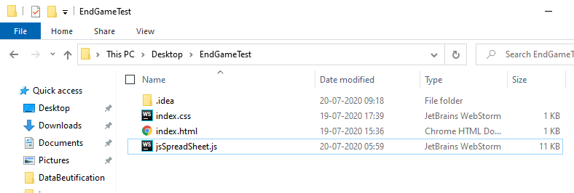
Project Files
index.css
index.html
jsSpreadSheet.js

Slide 6
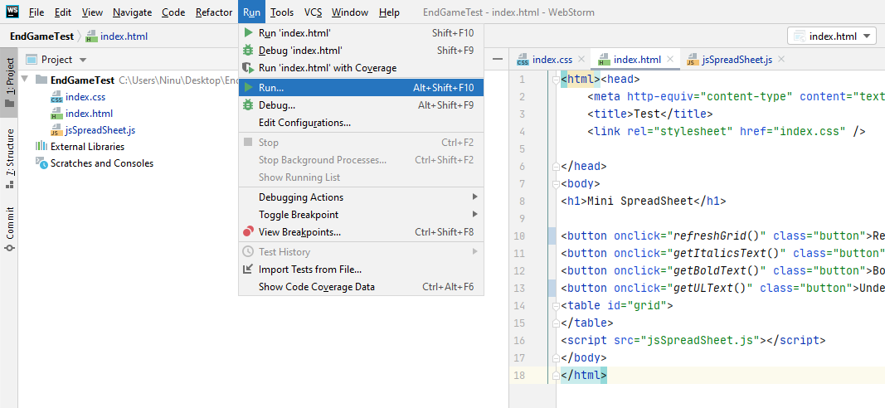
Editor- JetBrains WebStorm

Slide 7
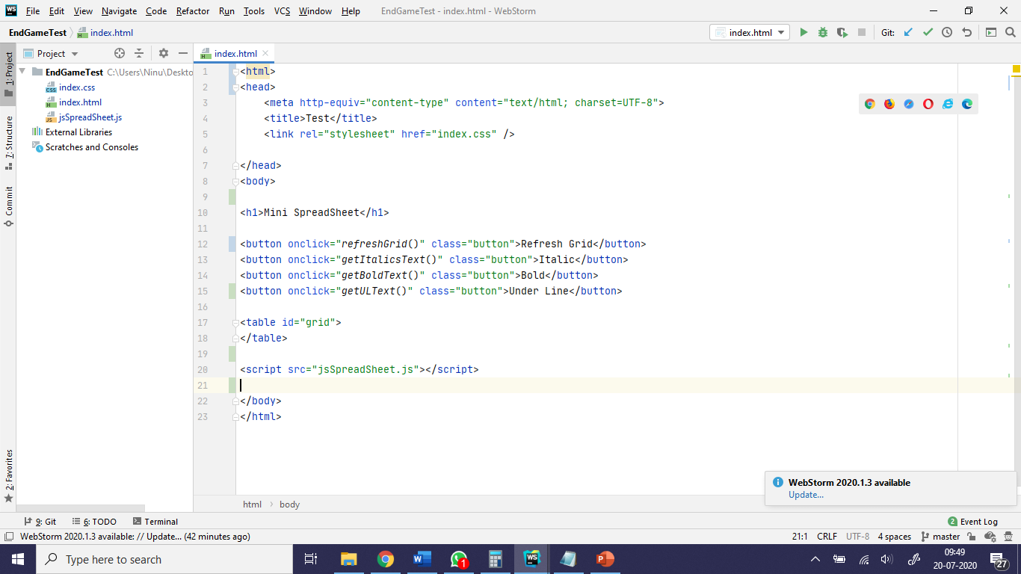
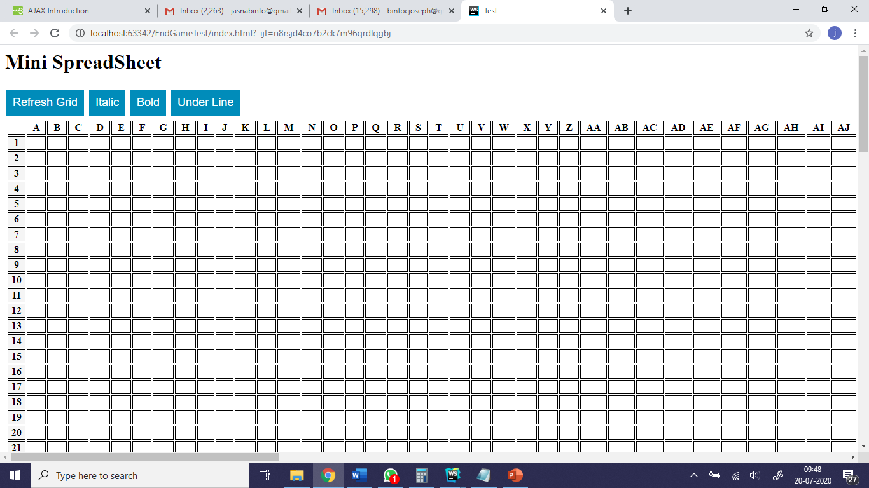
Coding -HTML

Slide 8
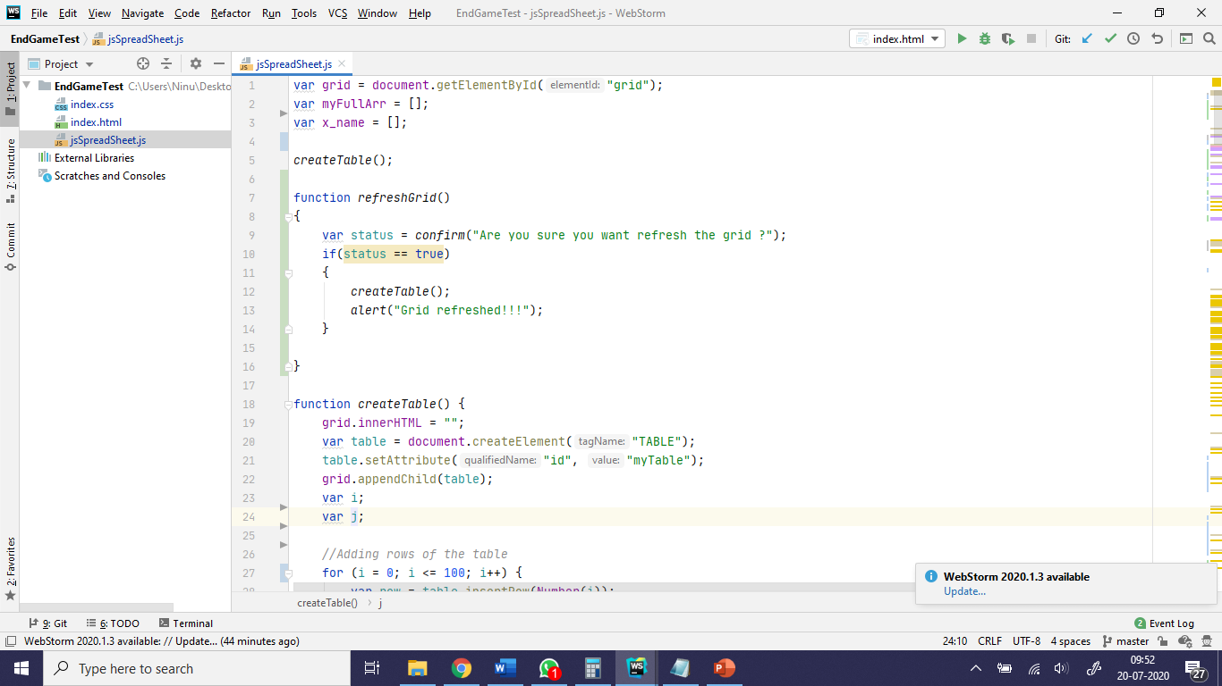
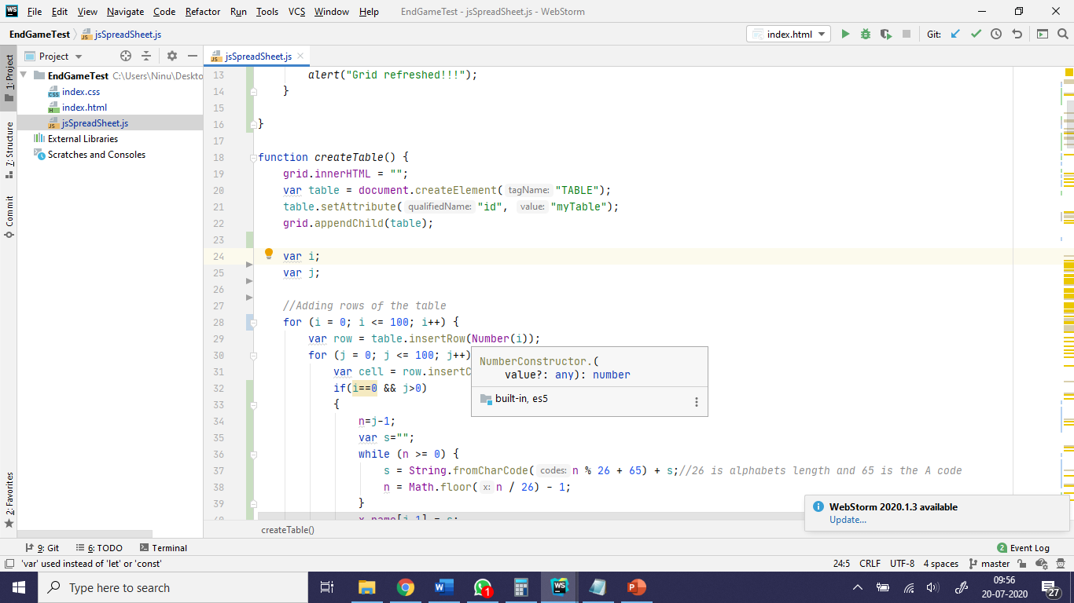
Coding JavaScript
Global declaration & HTML page load method
Dynamically adding new table to html table with id “grid”

Slide 9
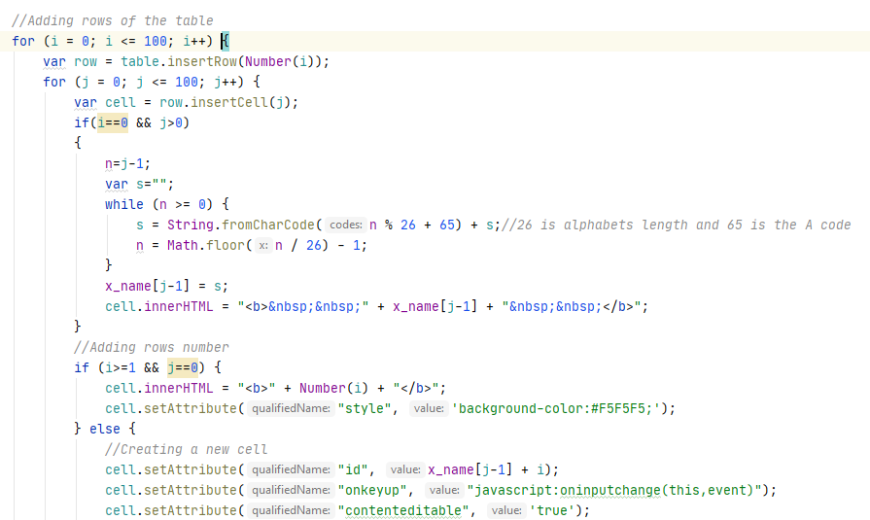
Coding JavaScript(Cont.) 100*100 cells table
j = 0; i = 0 for
i = 0 first row and j > 0 from second column
If j==1 then n = 0
s = n % 26 + 65 = 0%26 + 65 = 65 -> A
n = n / 26 = 0/26 = 0 -1 = -1 exit while
…Same A to Z
Now to get names after Z i.e AA,AB,AC….
To get AA, now n= 26
s = n % 26 + 65 = 26%26 + 65 = 65 -> A
n = n / 26 = 26/26 = 1 - 1 = 0 ,
again while loop, now n=0
s = n % 26 + 65 = 0%26 + 65 = 65 -> A
s= s + A = AA
n = n / 26 = 0/26 = 0 -1 = -1 exit while

Slide 10
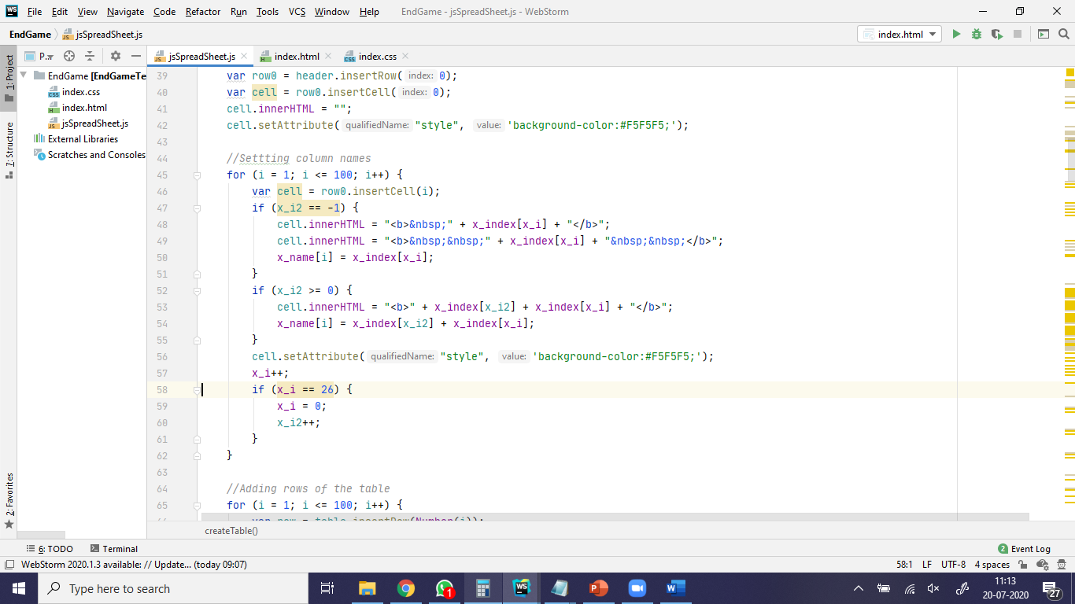
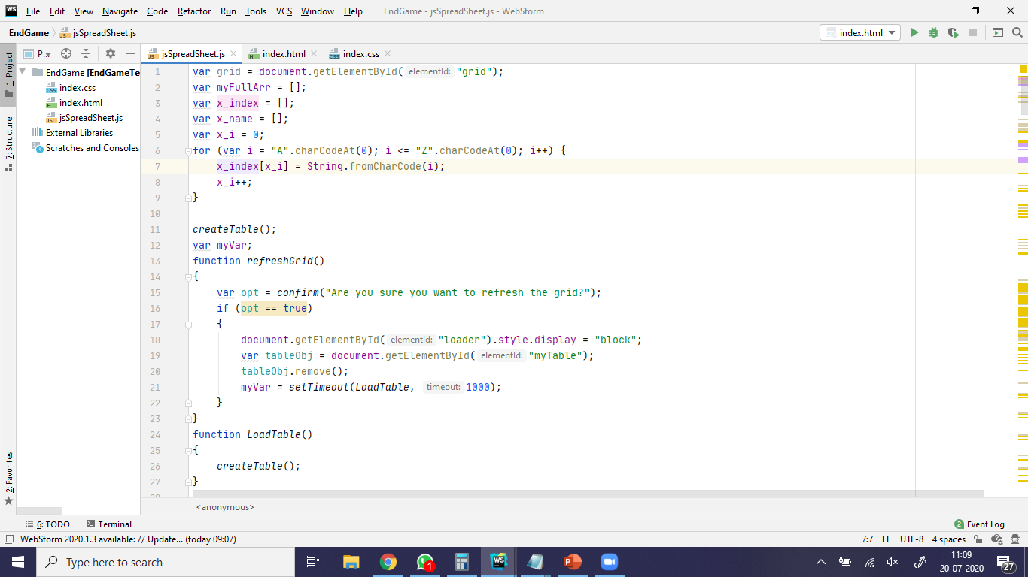
Previous code used for calculating Column Labels

Slide 11
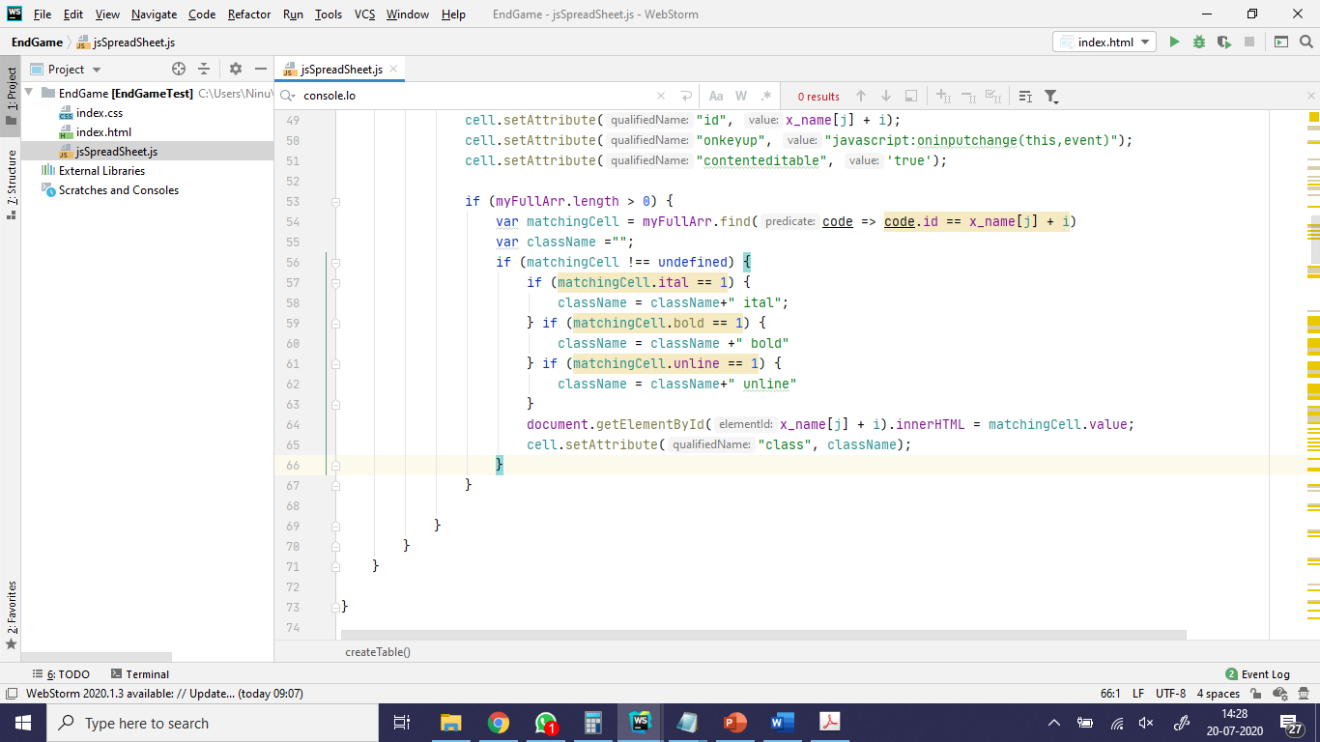
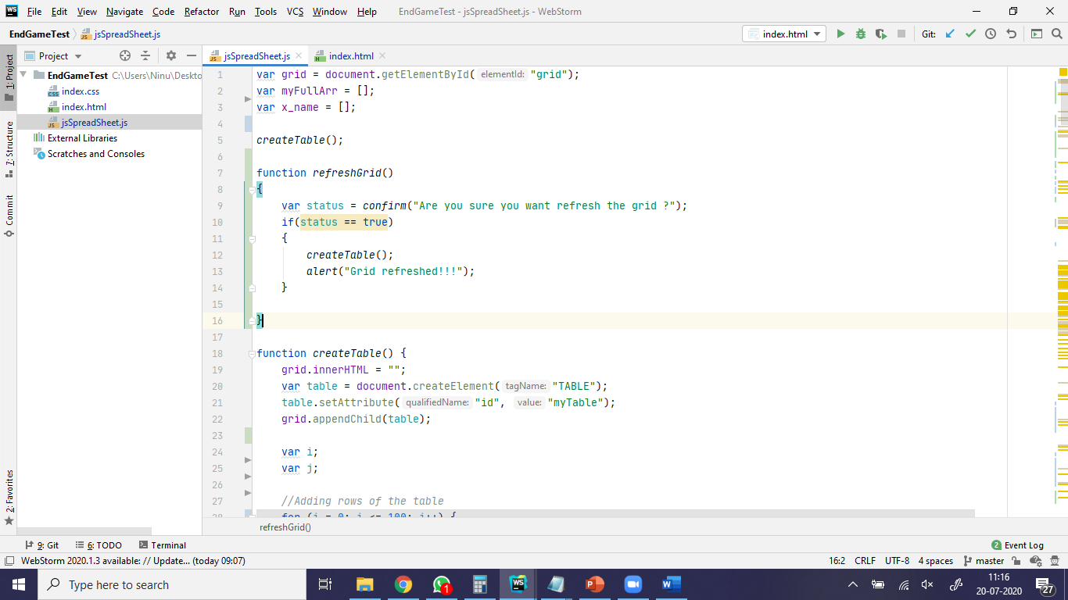
Coding JavaScript(Cont.) Refresh button

Slide 12
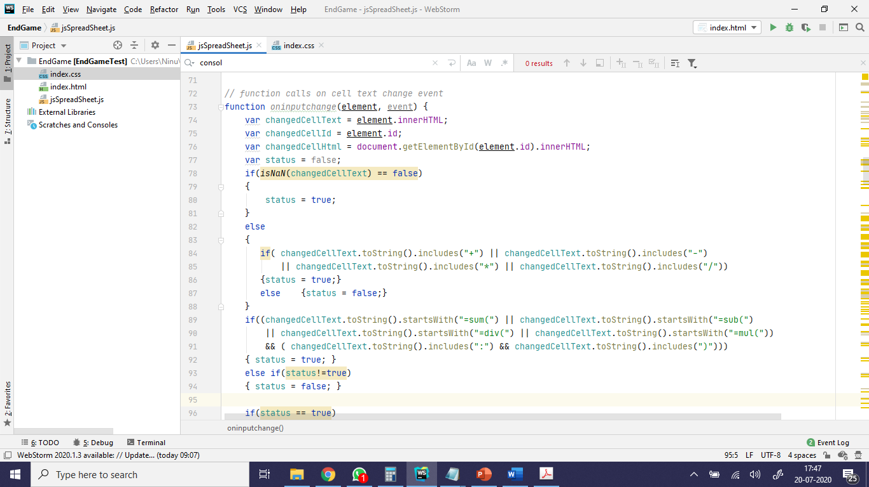
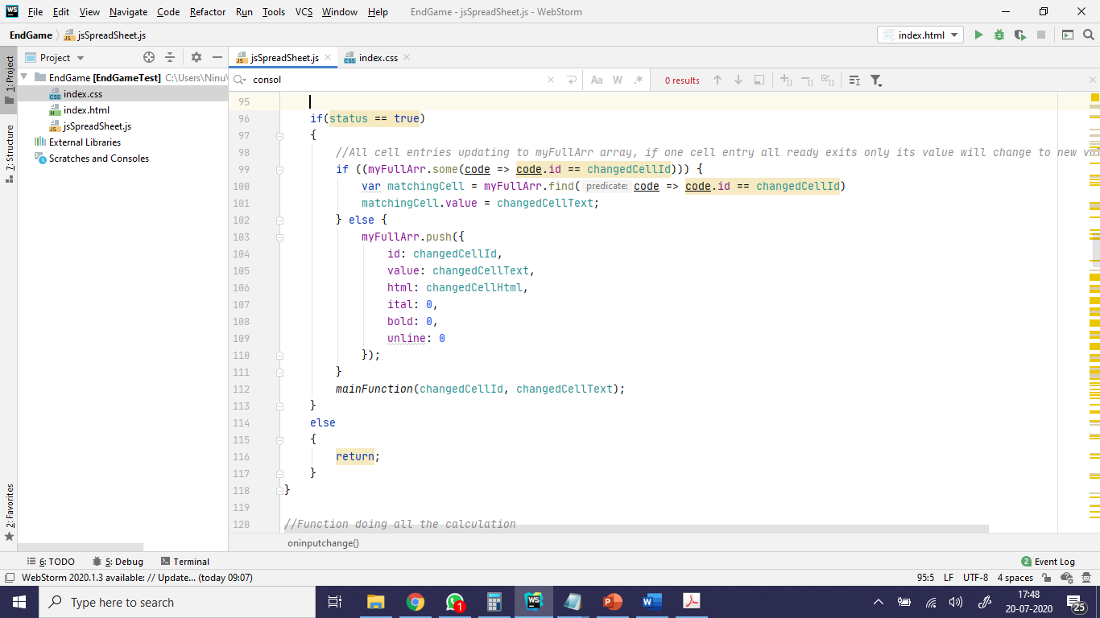
Coding JavaScript(Cont.) Cell key up storing data

Slide 13
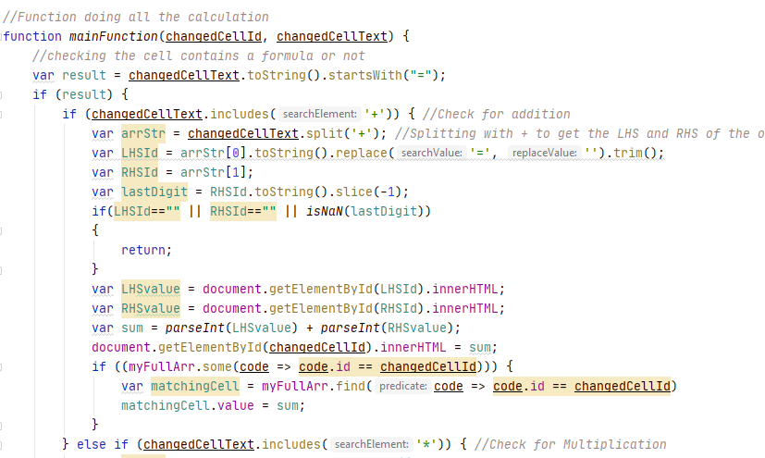
Coding JavaScript(Cont.) Formula support

Slide 14
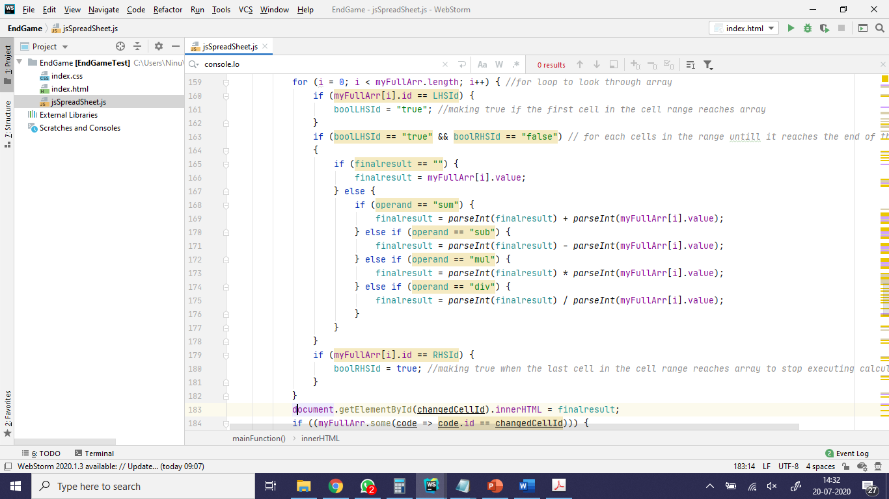
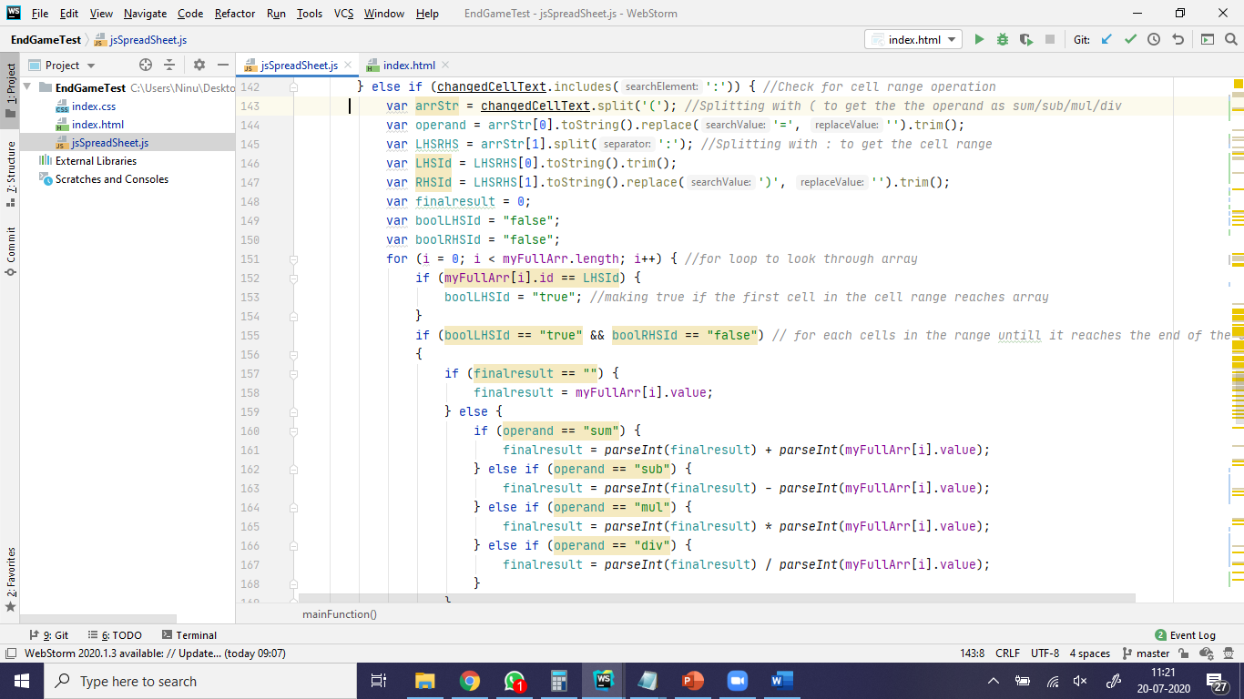
Coding JavaScript(Cont.) Function Support

Slide 15
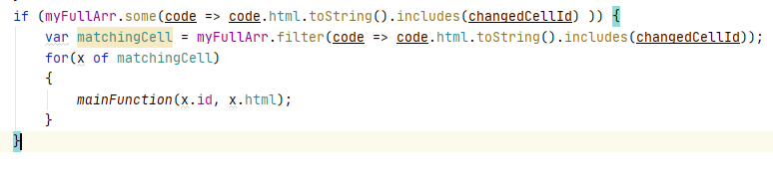
Coding JavaScript(Cont.) Formula & Function support
If a cell value changed all formulas accepting that cell value, is getting recalculated

Slide 16
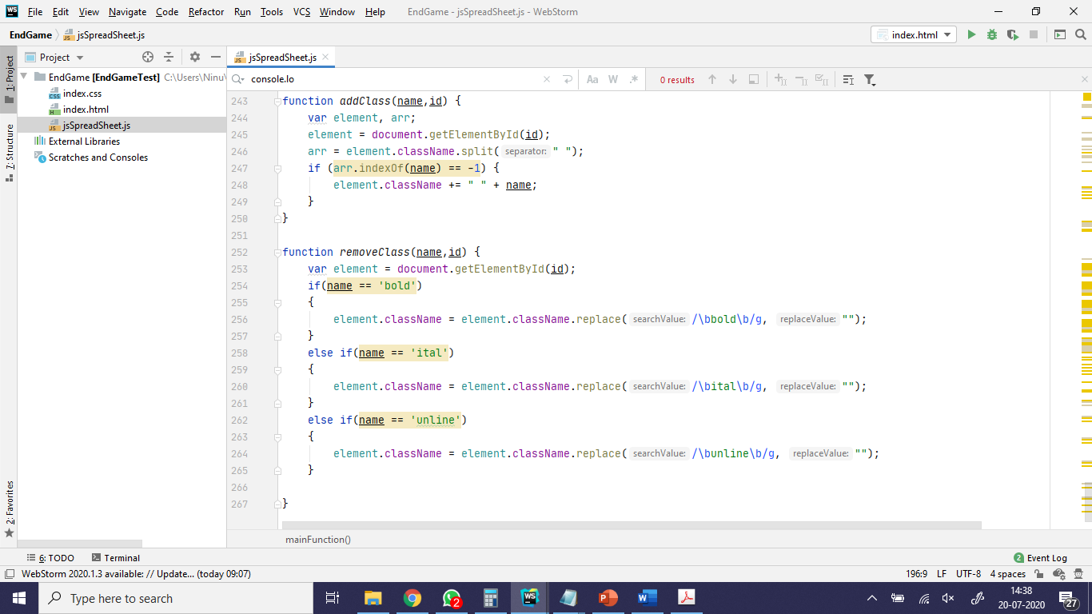
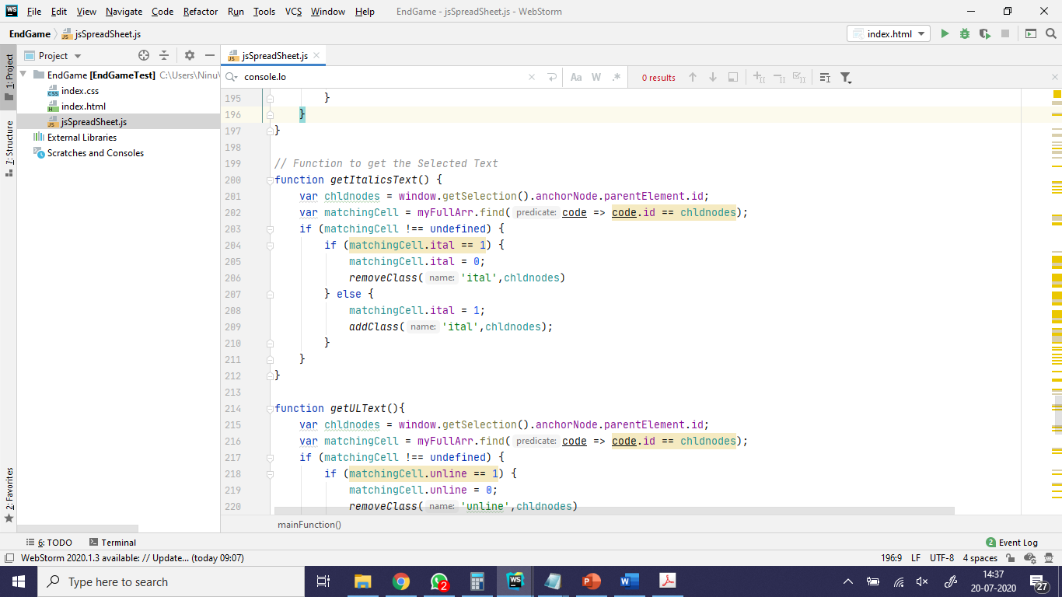
Coding JavaScript(Cont.) Formatting support

Slide 17
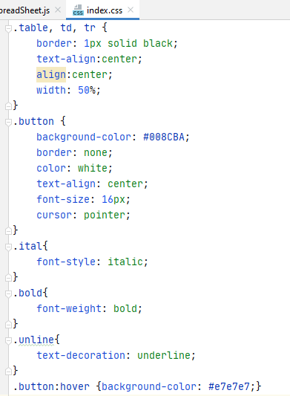
CSS

Slide 18
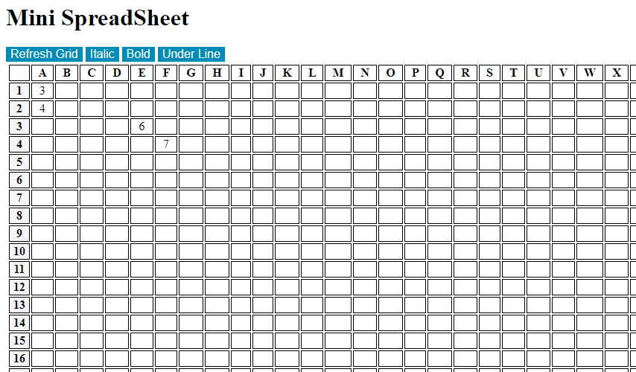
OUTPUT

Slide 19
THANK YOU

